Slide 1
Linear Classifiers
Itay Hazan

Slide 2
Spam or Ham
How would you classify this data?
Email Length
New Recipients

Slide 3
Linear Classifiers
How would you classify this data?
Email Length
New Recipients

Slide 4
When a new email is sent
Place the new email in the space
Classify it according to the subspace in which it resides
Email Length
New Recipients

Slide 5
Which separator should we choose?
How would you classify this data?
Email Length
New Recipients

Slide 6
Which separator should we choose?
How would you classify this data?
Email Length
New Recipients

Slide 7
Which separator should we choose?
How would you classify this data?
Email Length
New Recipients

Slide 8
Which separator should we choose?
Any of these would be fine..
..but which is best?
Email Length
New Recipients

Slide 9
Classifier Margin
Define the margin of a linear classifier as the width that the boundary could be increased by before hitting a data point.
Email Length
New Recipients

Slide 10
Maximum Margin
The maximum margin linear classifier is the linear classifier with the, maximum margin.
This is the simplest kind of SVM (Called an LSVM)
Email Length
New Recipients
Linear SVM

Slide 11
No Linear Classifier can cover all instances
How would you classify this data?
Email Length
New Recipients

Slide 12
Ideally, the best decision boundary should be the one which provides an optimal performance such as in the following figure

Slide 13
No Linear Classifier can cover all instances
Email Length
New Recipients

Slide 14
However, our satisfaction is premature because the central aim of designing a classifier is to correctly classify novel input
Issue of generalization!

Slide 15
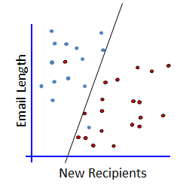
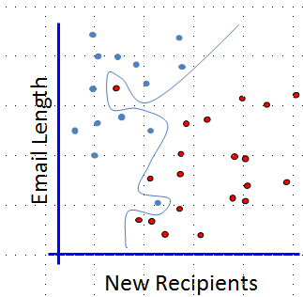
Which one?
2 Errors
Simple model
0 Errors
Complicated model

Slide 16
Evaluating What’s Been Learned
We randomly select a portion of the data to be used for training (the training set)
Train the model on the training set.
Once the model is trained, we run the model on the remaining instances (the test set) to see how it performs
Confusion Matrix
Classified As
Red | Gray
1 | 7 | Gray
5 | 0 | Red
Email Length
Actual
New Recipients

Slide 17
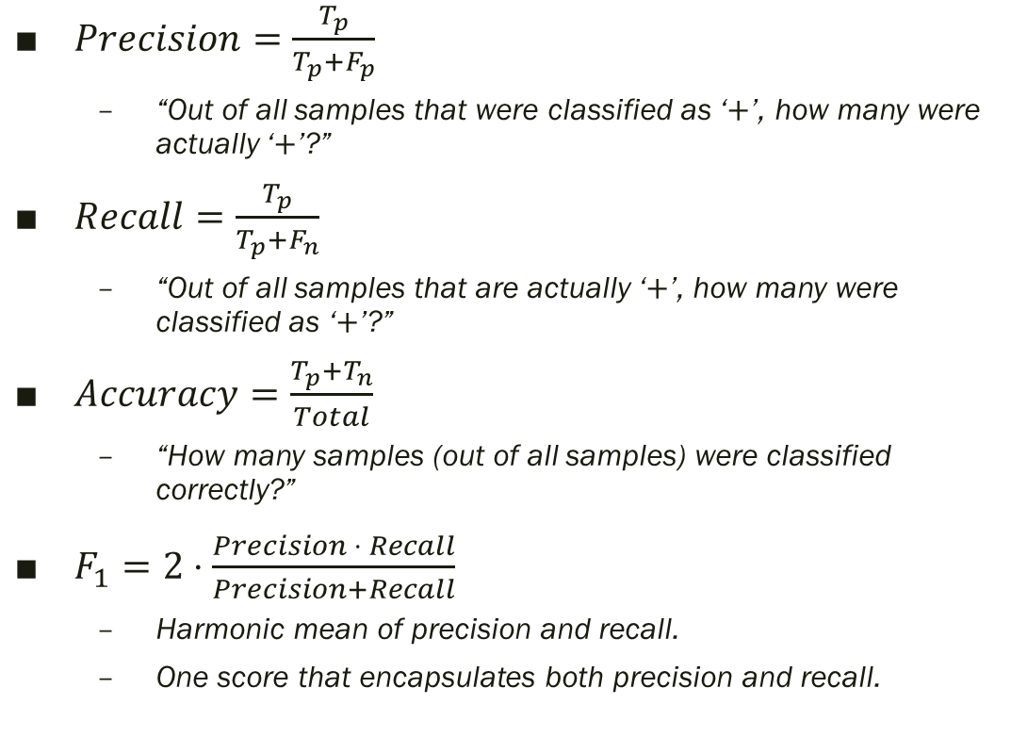
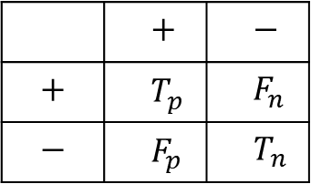
Accuracy, Precision, and Recall
$Precision=\frac{T_{p}}{T_{p}+F_{p}}$
“Out of all samples that were classified as ‘$+$’, how many were actually ‘$+$’?”
$Recall=\frac{T_{p}}{T_{p}+F_{n}}$
“Out of all samples that are actually ‘$+$’, how many were classified as ‘$+$’?”
$Accuracy=\frac{T_{p}+T_{n}}{Total}$
“How many samples (out of all samples) were classified correctly?”
$F_{1}=2⋅\frac{Precision ⋅ Recall}{Precision+Recall}$
Harmonic mean of precision and recall.
One score that encapsulates both precision and recall.
Confusion Matrix
Classified As
$$−$$ | $$+$$
$$F_{n}$$ | $$T_{p}$$ | $$+$$
$$T_{n}$$ | $$F_{p}$$ | $$−$$
Actual

Slide 18
The Non-linearly separable case
Email Length
New Recipients

Slide 19
The Non-linearly separable case
Email Length
New Recipients

Slide 20
The Non-linearly separable case
Email Length
New Recipients

Slide 21
The Non-linearly separable case
Email Length
New Recipients

Slide 22
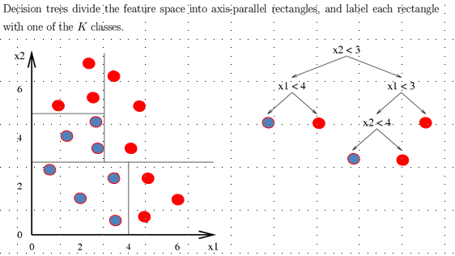
Decision tree
A flow-chart-like tree structure
Internal node denotes a test on an attribute
Branch represents an outcome of the test
Leaf nodes represent class labels or class distribution

Slide 23
Top Down Induction of Decision Trees
Email Len
<1.8
≥1.8
Spam
Ham
Email Length
1 Error
8 Errors
New Recipients

Slide 24
Top Down Induction of Decision Trees
Email Len
<1.8
≥1.8
Spam
Ham
Email Length
1 Error
8 Errors
New Recip
New Recipients
<2.3
≥2.3
Spam
Ham
4 Errors
11 Errors

Slide 25
Top Down Induction of Decision Trees
Email Len
<1.8
≥1.8
Spam
Email Len
Email Length
1 Error
<4
≥4
Ham
Spam
New Recipients
3 Errors
1 Error

Slide 26
Top Down Induction of Decision Trees
Email Len
<1.8
≥1.8
Spam
Email Len
Email Length
1 Error
<4
≥4
Spam
New Recip
New Recipients
1 Error
<1
≥1
Spam
Ham
0 Errors
1 Error

Slide 27
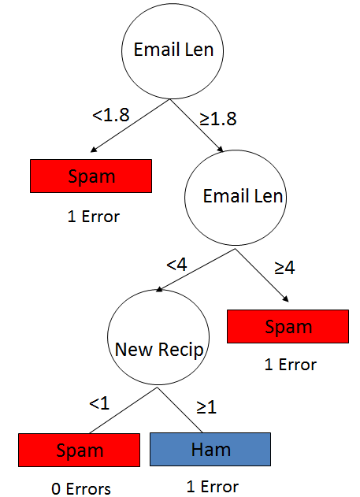
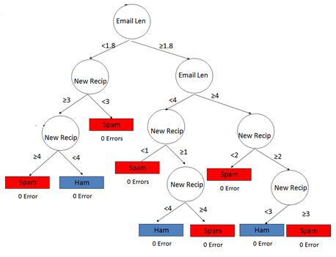
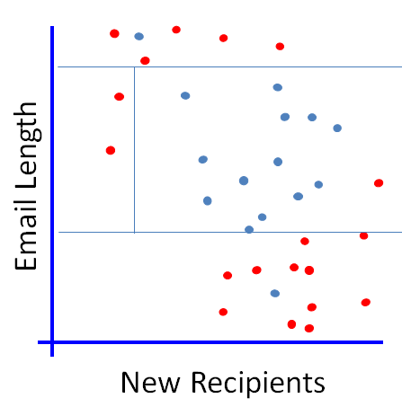
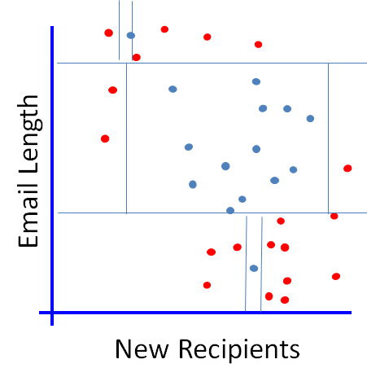
Which One?

